Slide 1
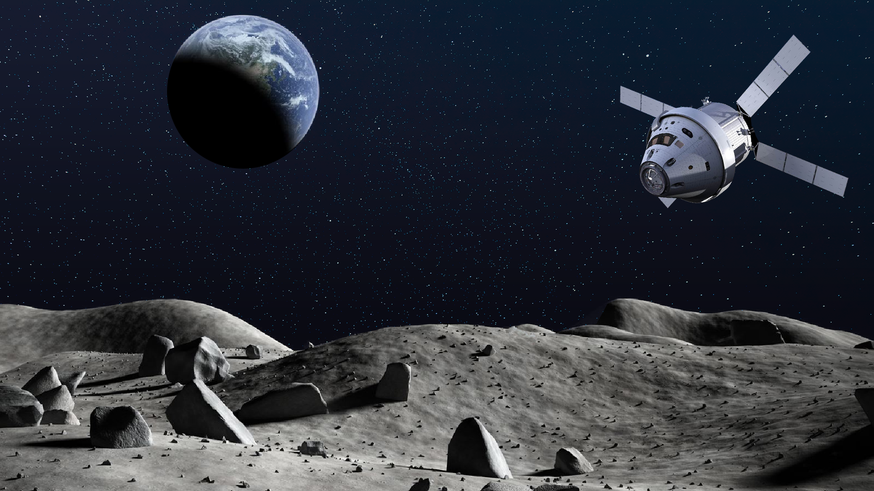
SATELLITE ENTERPRENEUR
CASE STUDY

Slide 2

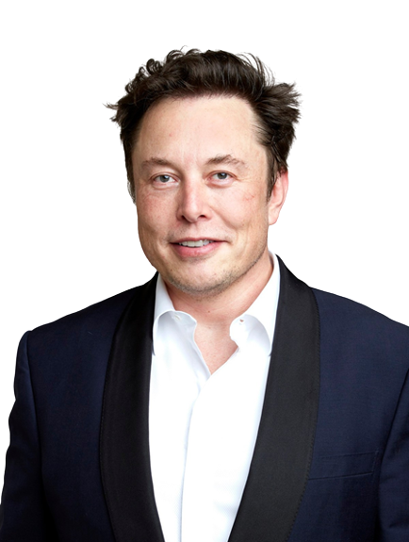
Elon Musk is a renowned entrepreneur who has made a major impact in the area of satellite entrepreneurship. He founded the company SpaceX in 2002 with the goal of revolutionizing space technology with the ultimate goal of making human life interplanetary. Through SpaceX, Musk has launched a variety of satellites, ranging from communication satellites to weather observation satellites.
ELON MUSK
ELON MUSK
He is the founder of SpaceX. Musk used satellite technology to launch a number of spacecraft and satellites into space, including the Falcon 9 rocket and the Dragon cargo capsule. These launches have enabled SpaceX to become the leading private space exploration company and have given Musk the opportunity to pursue his dream of sending humans to Mars.

Slide 3
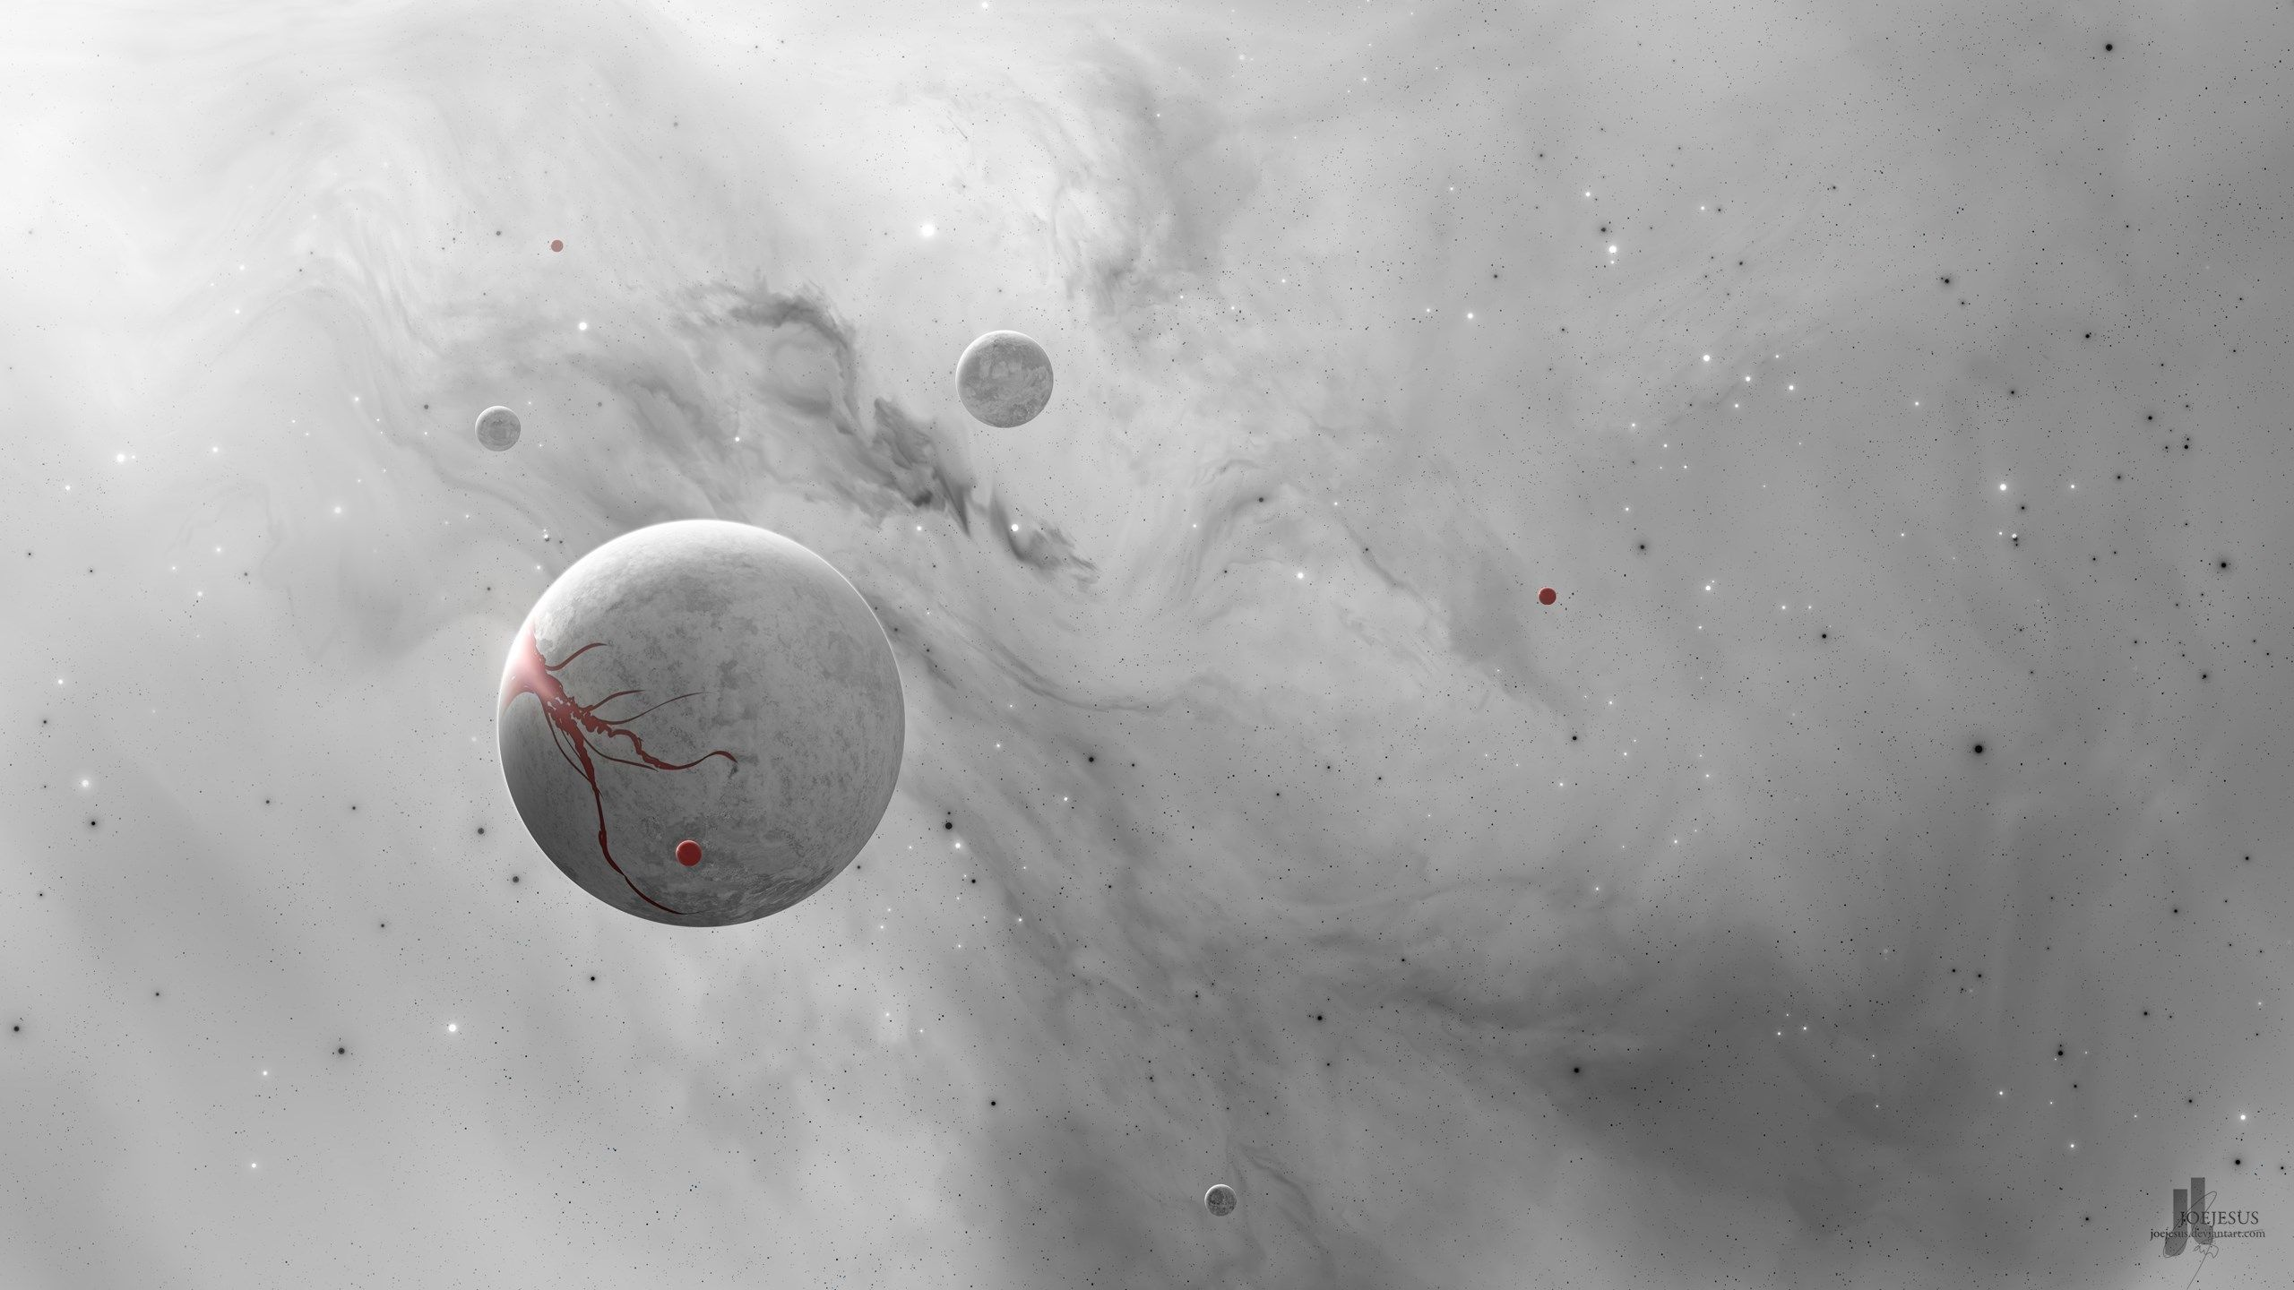

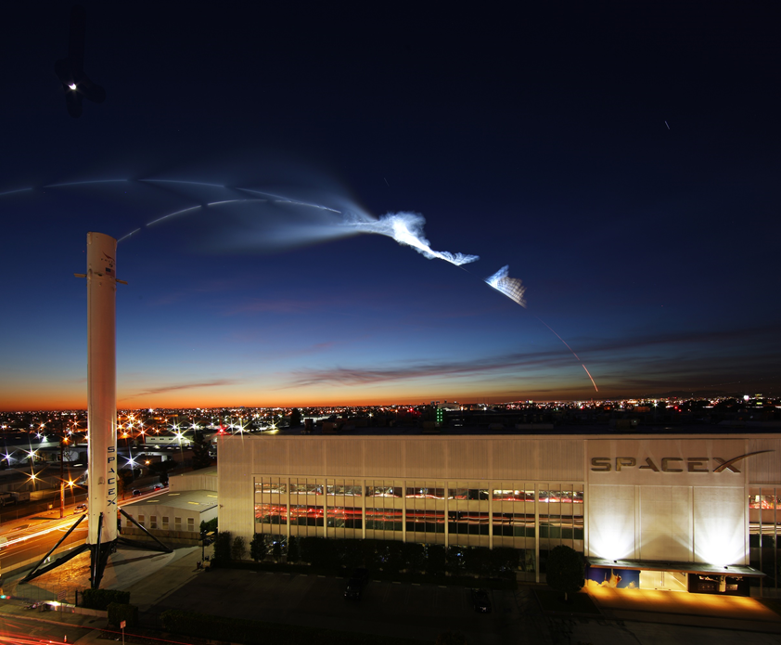
Headquarters
Headquarters

Slide 4

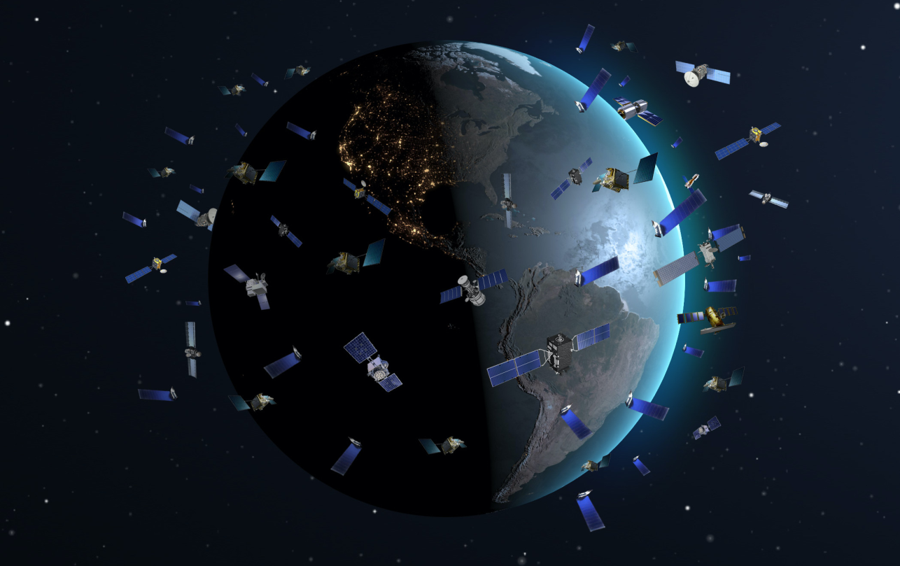
Starlink Constellation
One of SpaceX’s most notable successes in satellite entrepreneurship has been the launch of its Starlink constellation. Starlink is a network of over 1,000 satellites that provide global broadband internet access. This ambitious project has been lauded for its potential to bring internet to remote areas of the world and make internet access more affordable.
Musk has also made strides in satellite technology by launching a variety of Earth observation satellites. These satellites have been used to monitor natural disasters, predict weather patterns, and help with navigation and navigation accuracy.

Slide 5
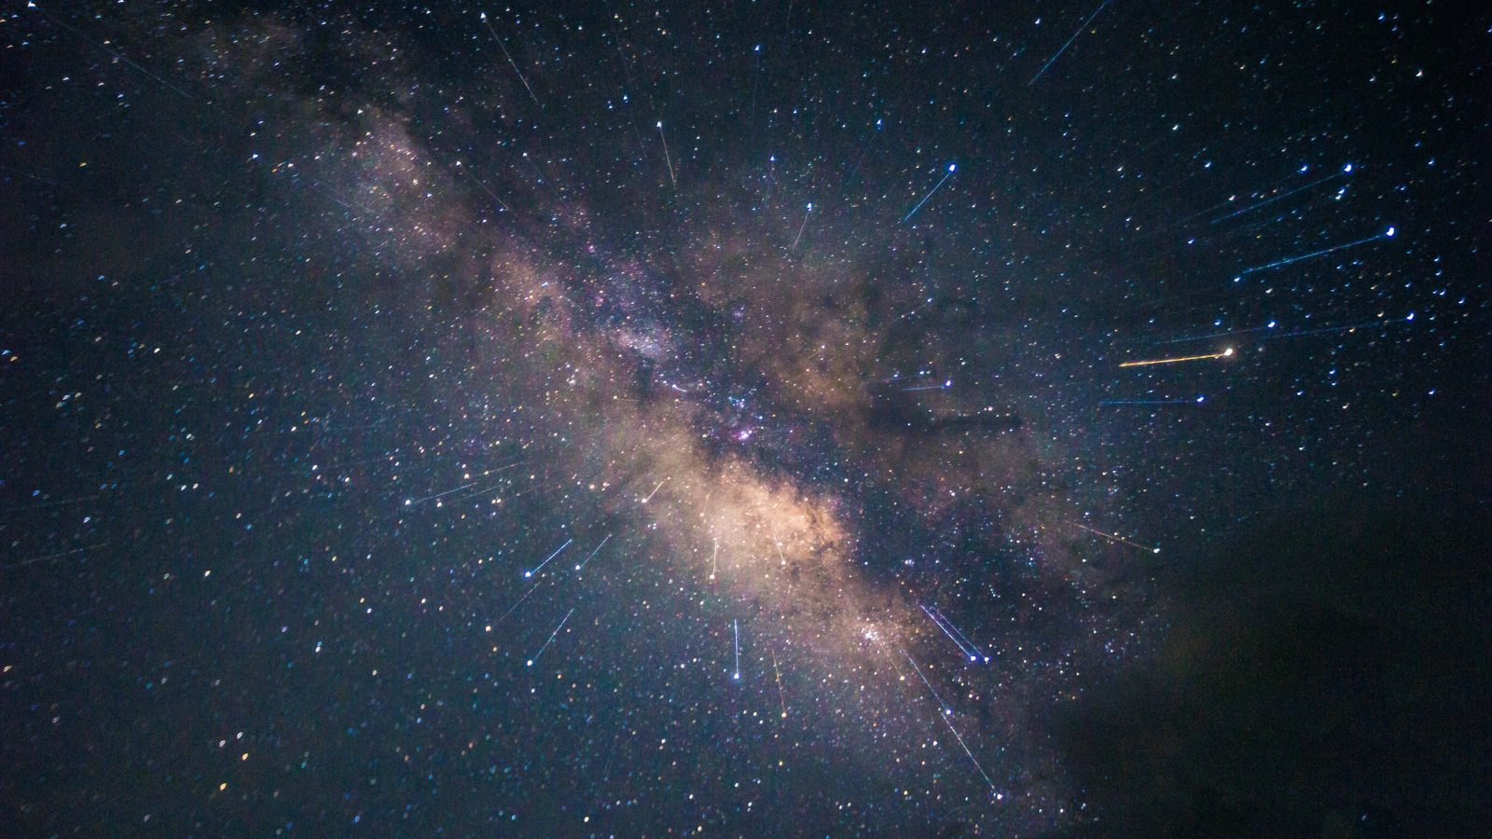
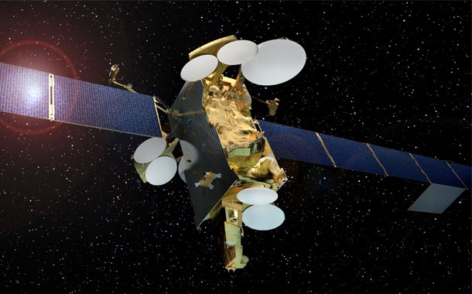
As of December 2022, SpaceX has over 3000 Starlink satellites in orbit, and announced having over one million active subscribers.
Musk is a big believer in the power of “thinking big” and setting lofty goals, but he also emphasizes the importance of being “data-driven” and making decisions based on facts and evidence. He encourages his teams to come up with creative solutions to challenges and to think “outside the box”.
SES 10 Satellite

Slide 6
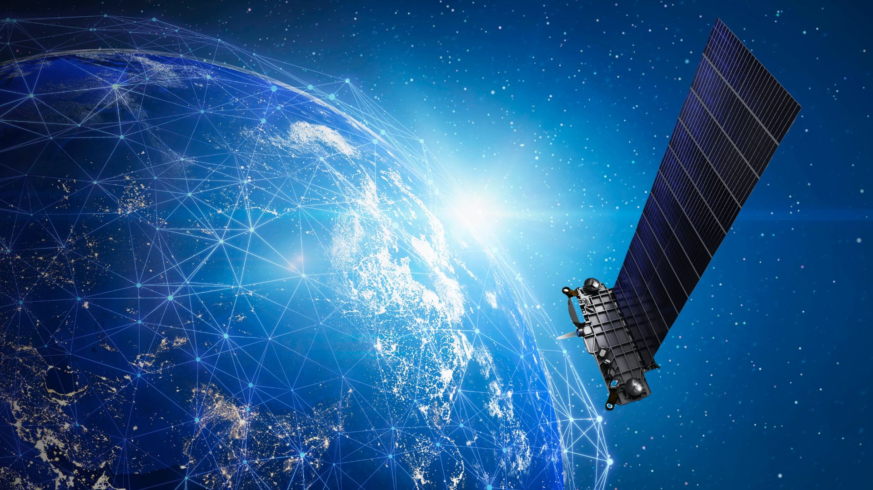
THANK YOU

